Slide 1
An Independent Task Scheduling Algorithm in Heterogeneous Multi-core Processor Environment
Lindong Liu and Deyu Qi
2018 IEEE 3rd Advanced Information Technology, Electronic and Automation Control Conference (IAEAC), Chongqing, 2018, pp. 142-146
Presenter : Chih-Kai Wu
Date: Dec. 29, 2020

Slide 2
Abstract(1/2)
Multi-core processor architecture is increasingly being used in high-performance computing. Task scheduling problem for performance heterogeneous multi-core processor is a well-known NP-complete problem. Based on heterogeneous multi-core processor environment, independent online task scheduling is studied in this paper. In this paper, a scheduling model of heterogeneous multi-core processors based on weighted earliest finish time is proposed, and the wEFT algorithm is proposed.

Slide 3
Abstract(2/2)
The wEFT algorithm selects the processor core to execute task with the minimum earliest completion time or the minimum weighted links of every processor core. Experiments show that compared with RR, wRR, LC and wLC algorithms under the environment of different number of tasks and processor cores, the makespan for the complete schedule of all tasks and average waiting time in wEFT algorithm is superior to other four algorithms.

Slide 4
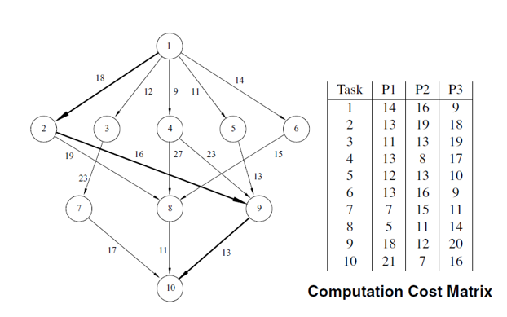
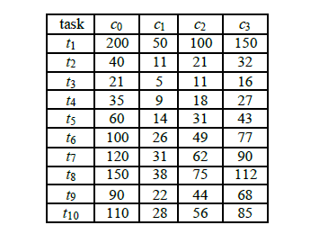
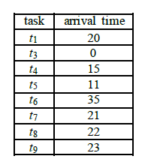

Slide 5
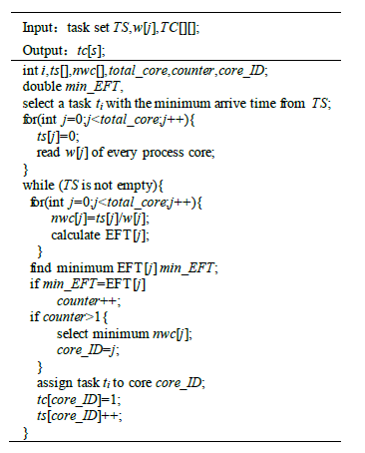

Slide 6
wEFT

Slide 7
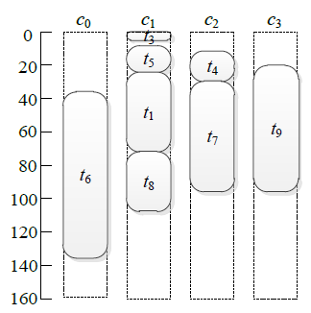
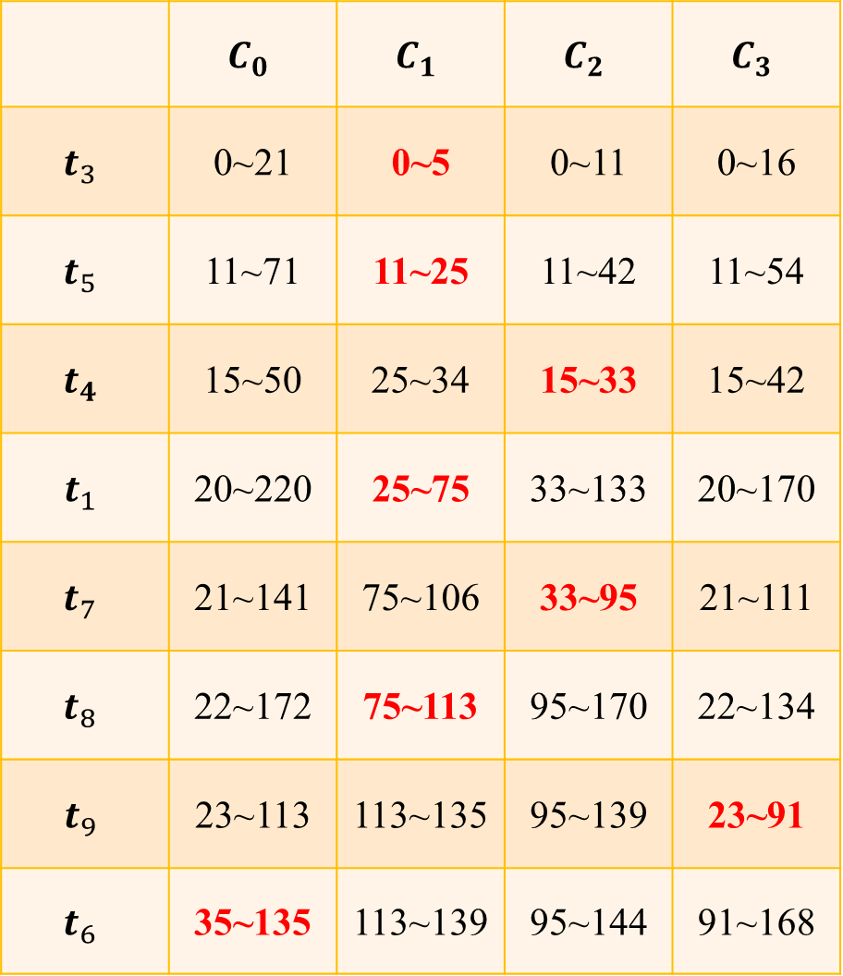
 | $$C_{0}$$ | $$C_{1}$$ | $$C_{2}$$ | $$C_{3}$$
$$t_{3}$$ | 0~21 | 0~5 | 0~11 | 0~16
$$t_{5}$$ | 11~71 | 11~25 | 11~42 | 11~54
$$t_{4}$$ | 15~50 | 25~34 | 15~33 | 15~42
$$t_{1}$$ | 20~220 | 25~75 | 33~133 | 20~170
$$t_{7}$$ | 21~141 | 75~106 | 33~95 | 21~111
$$t_{8}$$ | 22~172 | 75~113 | 95~170 | 22~134
$$t_{9}$$ | 23~113 | 113~135 | 95~139 | 23~91
$$t_{6}$$ | 35~135 | 113~139 | 95~144 | 91~168

Slide 8
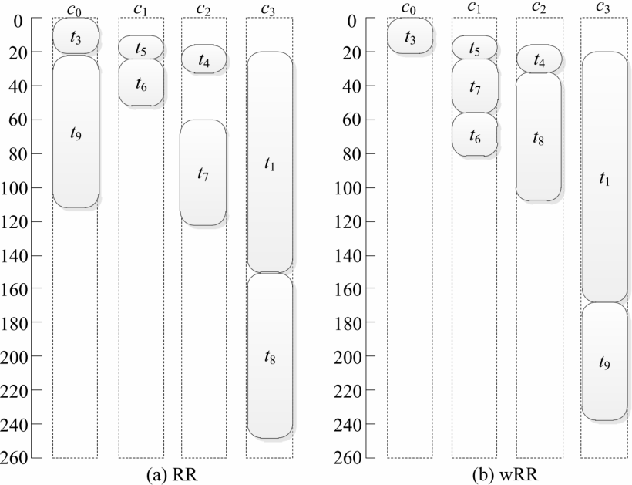
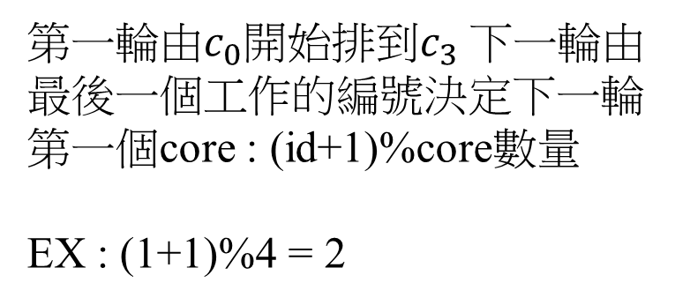
RR and wRR
第一輪由$c_{0}開始$排到$c_{3}$下一輪由最後一個工作的編號決定下一輪第一個core : (id+1)%core數量
EX : (1+1)%4 = 2

Slide 9
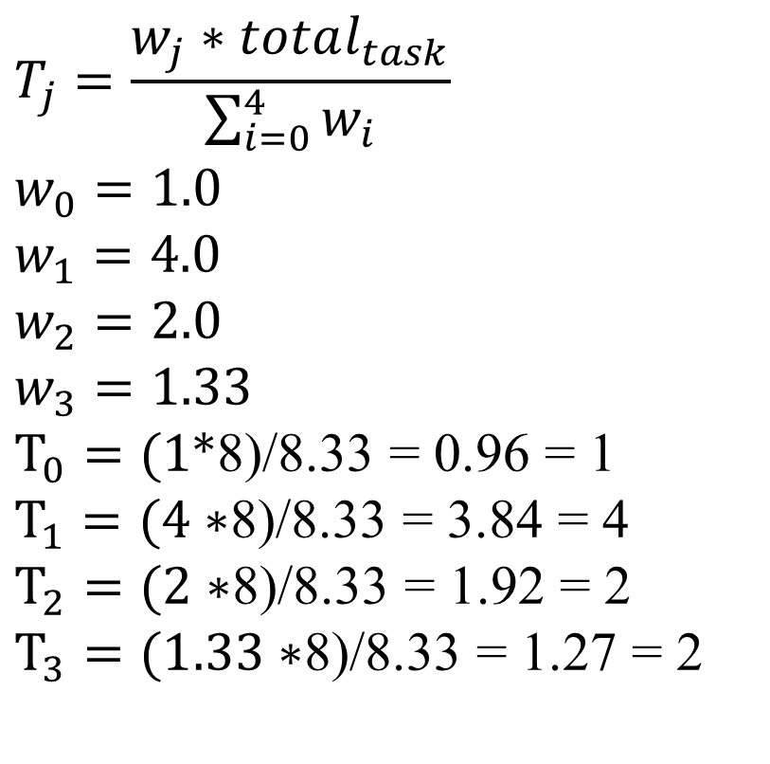
RR and wRR
$$T_{j}=\frac{w_{j}∗total_{task}}{\sum_{i=0}^{4}{w_{i}}}$$
$$w_{0}=1.0$$
$$w_{1}=4.0$$
$$w_{2}=2.0$$
$$w_{3}=1.33$$
$T_{0}=(1∗$8)/8.33 = 0.96 = 1
$T_{1}=(4∗$8)/8.33 = 3.84 = 4
$T_{2}=(2∗$8)/8.33 = 1.92 = 2
$T_{3}=(1.33∗$8)/8.33 = 1.27 = 2

Slide 10
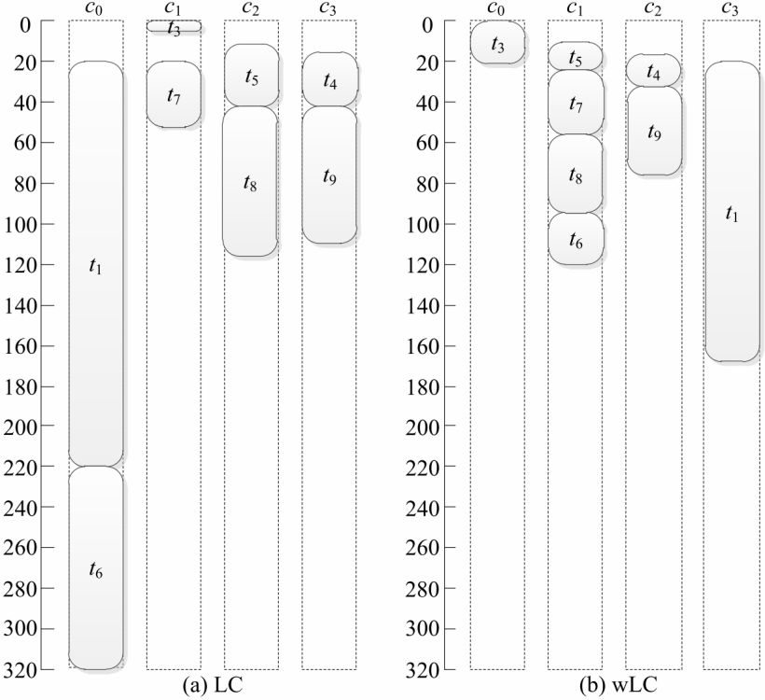

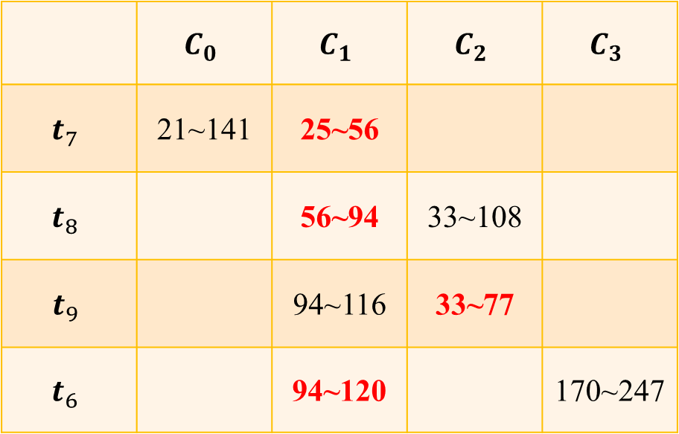
wLC
$$T_{j}=\frac{({ts}_{j}/w_{j})∗total_{task}}{\sum_{i=0}^{4}{({ts}_{i}/w_{i})}}$$
$$w_{0}=1.0 T_{0}=3.2$$
$$w_{1}=4.0 T_{1}=0.8$$
$w_{2}=2.0$ $T_{2}=1.6$
$w_{3}=1.33$ $T_{3}=2.4$
 | $$C_{0}$$ | $$C_{1}$$ | $$C_{2}$$ | $$C_{3}$$
$$t_{7}$$ | 21~141 | 25~56
$$t_{8}$$ |  | 56~94 | 33~108
$$t_{9}$$ |  | 94~116 | 33~77
$$t_{6}$$ |  | 94~120 |  | 170~247

Slide 11
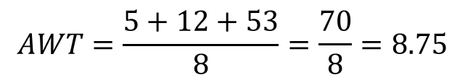
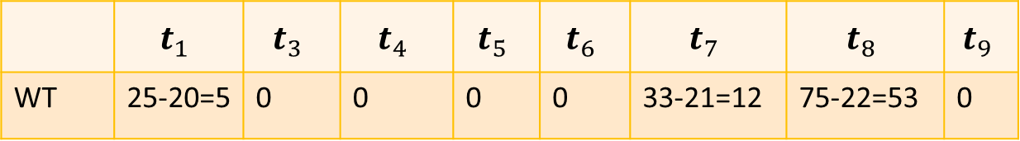
 | $$t_{1}$$ | $$t_{3}$$ | $$t_{4}$$ | $$t_{5}$$ | $$t_{6}$$ | $$t_{7}$$ | $$t_{8}$$ | $$t_{9}$$
WT | 25-20=5 | 0 | 0 | 0 | 0 | 33-21=12 | 75-22=53 | 0
$$AWT=\frac{5+12+53}{8}=\frac{70}{8}=8.75$$

Slide 12
